Slide 1
ECE 530 Cloud Computing
Ioannis Papapanagiotou
AWS EC2 & EBS

Slide 2

Compute
Amazon Elastic Cloud Compute (EC2) is a simple web service interface allows you to obtain and configure capacity with minimal friction.
EC2 allows to provision virtual instances.
These instances can be CentOS, Ubuntu, Amazon’s linux, Windows 2008/2012 etc.
Amazon also provides a marketplace where you can pre-configured instances.
EC2 uses Xen virtualization.
Notes:
Amazon Elastic Compute Cloud (EC2) provides scalable virtual private servers using Xen.

Slide 3
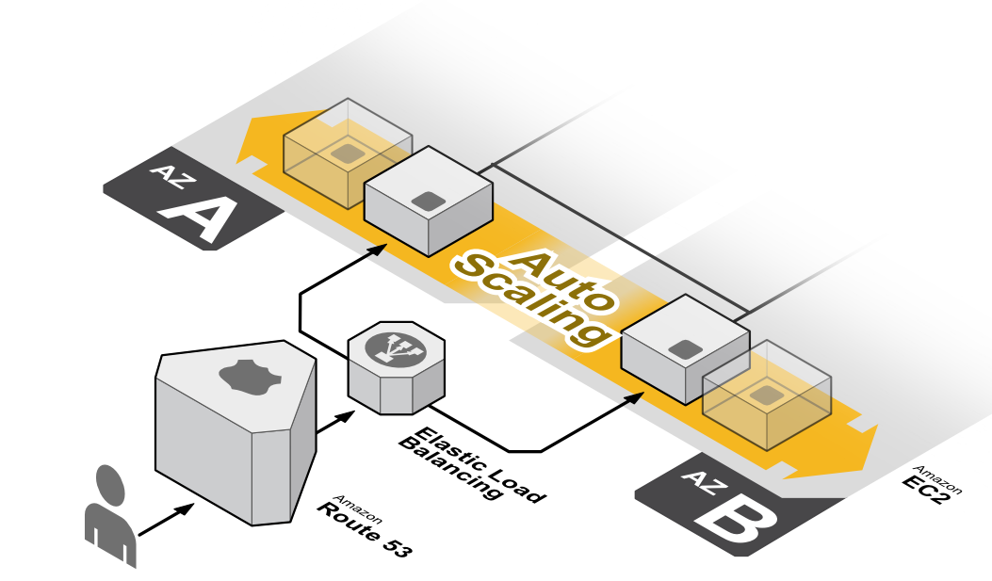
Autoscaling

Slide 4
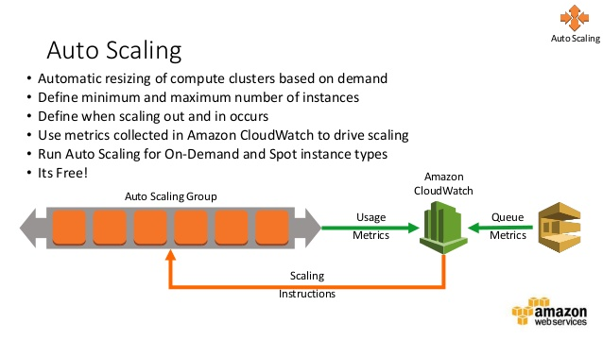
Autoscaling
Notes:
You can autoscale if my CPU hits 80% and then configure it accordingly.

Slide 5
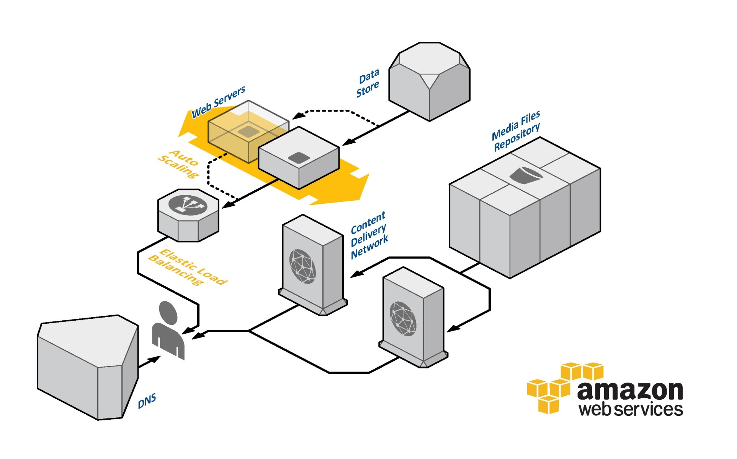
Elastic Load Balancing

Slide 6
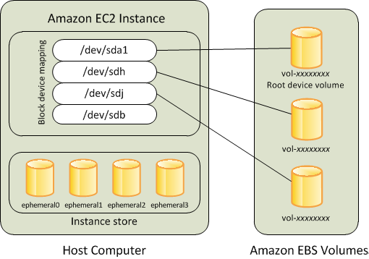
Amazon EBS
Amazon Elastic Block Storage (EBS) provides raw block devices that can be attached with EC2 instances.
EBS supports a number of advanced storage features, including snapshotting and cloning.
EBS volumes can be up to 1TB in size.
EBS volumes are built on replicated storage, so that the failure of a single component will not cause data loss.

Slide 7
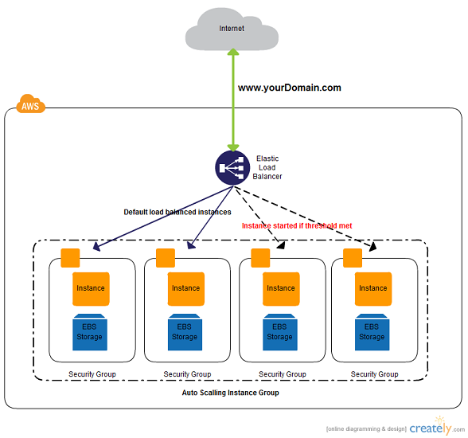
EC2 & EBS
I2.4xlarge

